Slide 1

Ethics in Computer Science Research
COMP 60990
Markel Vigo
markel.vigo@manchester.ac.uk
Bio-Health Informatics Group
Notes:
Why me?
In the following weeks you will choose a MSc project

Slide 2
Schedule: contact hours
Today:
Part 1. Introduction to research ethics. 45 min
Part 2. Introduction to the U. of Manchester Ethics application process. 30 min
Part 3. Groups start discussing ethical issues in the given scenarios. 35 min
Next week:
Part 4. Groups report back. 1 hour

Slide 3
Schedule: self-study
Task 1. Work on Part 3
Task 2. Reflect on whether your project needs ethical approval

Slide 4
Part I. Introduction to CS research ethics

Slide 5
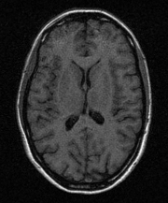
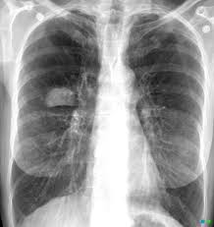
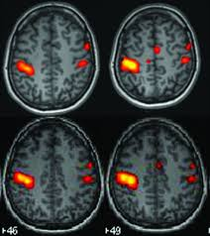

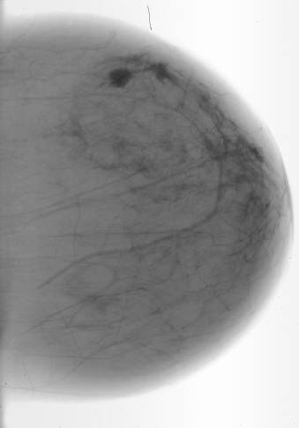
What is Ethical Research?
“The dignity, rights, safety and well being of human participants must at all times be considered, respected and safeguarded. This includes research subjects, their tissues, organs or personal data”
Name
Address
Phone Number
Bank Account
Academic Record
Medical Records
Photographs
etc

Slide 6


Ethics in CS research?
It’s about protecting:
Data
Humans
Notes:
Data → Collection, Generation, Retrieval, Analysis. Knowledge generation from data!
Humans→ HCI, testing software, human-in-the loop

Slide 7
Typical scenarios
The experimenter creates a poster to recruit participants and says £10 will be awarded to those taking part
The experimenter recruits participants in the classroom or corridors of the school
A student asks their supervisor to send a request letter out to his current students

Slide 8
Ethics
Morality
Law
Notes:
These three concepts are about what’s right or wrong OR bad and good.
Morality: Principles or habits with respect to right or wrong conduct. While morals also prescribe dos and don'ts, morality is ultimately a personal compass of right and wrong.

Slide 9
Morality
Principles or habits with respect to right or wrong conduct
Ultimate
Universal
Impartial
Other-regarding
Notes:
Ultimate: values are of the greatest importance and cannot be overridden by lesser values.
Universal: it applies to anyone within a community.
Impartial: moral evaluations must treat the good of everyone alike.
Other regarding: they place the good others above the self-interest.

Slide 10

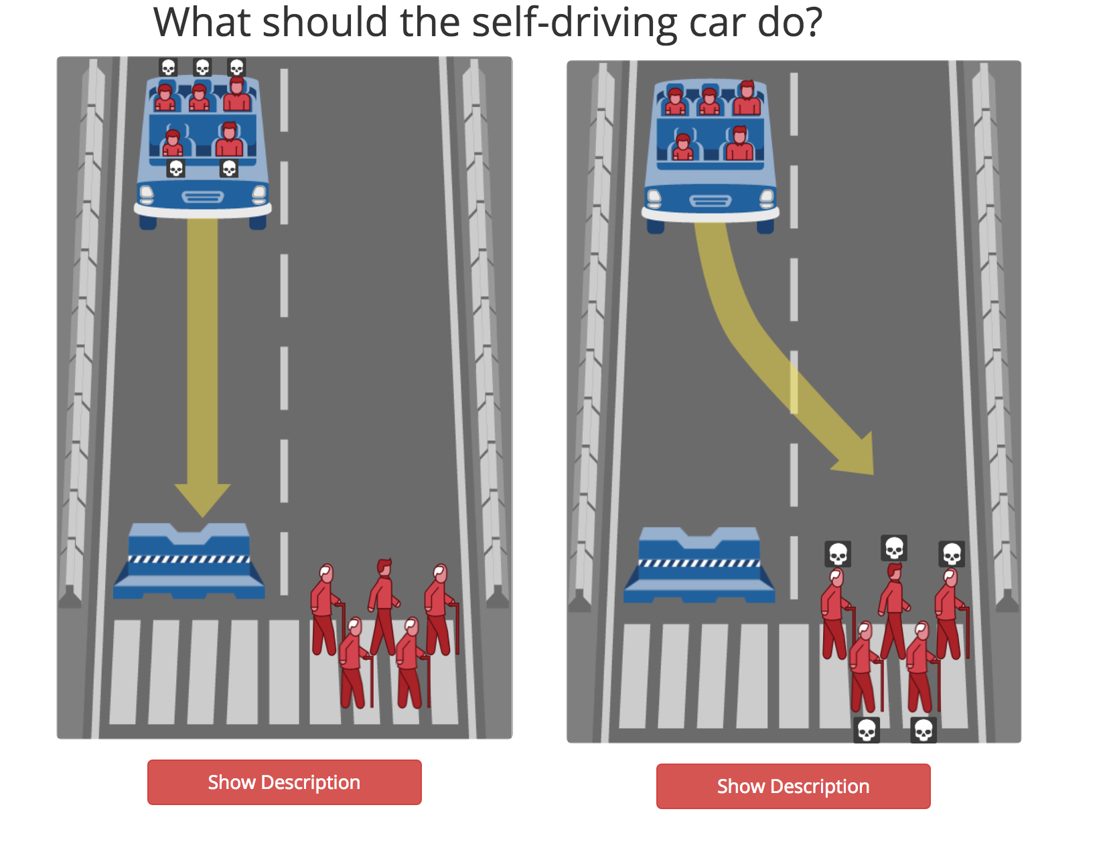
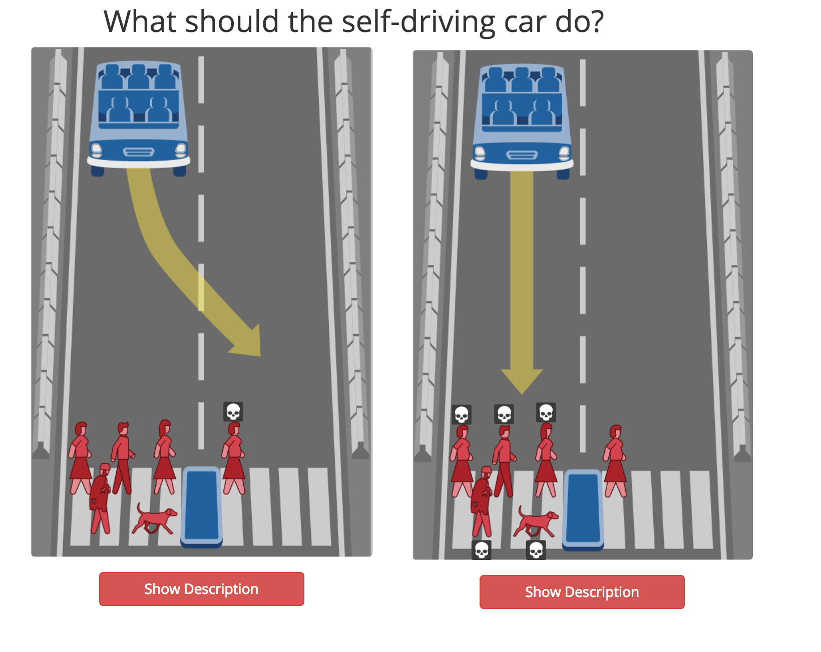
http://moralmachine.mit.edu/
Notes:
Ultimate: values are of the greatest importance and cannot be overridden by lesser values.
Universal: it applies to anyone within a community.
Impartial: moral evaluations must treat the good of everyone alike.
Other regarding: they place the good others above the self-interest.

Slide 11
Ethics
Morality
Law
Notes:
Ethics: The rules of conduct recognized in respect to a particular class of human actions or a particular group or culture.

Slide 12
Ethical frameworks
Virtue ethics
Duty based
Utilitarian
Applied ethics
Notes:
Virtue: it looks at the moral character of the person. Person oriented, virtuousness is justice, fidelity. self-care, prudence -- Aristotle
Duty: obligation to act morally, no matter the consequences, which is sth you cannot control but it’s your intentions what matters -- Kant
Utilitarian: to achieve utility you must balance good and bad effects: it’s an optimisation problem -- maximise good consequences, minimise bad ones. The greatest happiness altogether. Or if they benefit the majority.
Applied ethics: professional, research, business or clinical

Slide 13
Ethical principles
Attempts to operationalise and critically examine the moral that guides human conduct
Respect for autonomy
Beneficence
Non-maleficence
Justice
Notes:
Autonomy: do not interfere with free choice, protect vulnerable people, foster self-determination
Beneficence: act to benefit others; balance good results over potential harms
Non-maleficence: avoid harm; balance risks and seriousness of potential harms against benefits
Justice: be fair

Slide 14
Ethics
Morality
Law

Slide 15
Law
Law | Ethics
“Must” | “Should”
Minimum standard of behaviour | Ideal or aspirational
Defined by government | Defined by the community
Formal rules | Informal guidelines
Coercive | Non-coercive
Notes:
Guidelines grounded in moral values
Coercive: enforceable and punished
Non-coercive but there are consequences, take responsibility for what’s done,

Slide 16
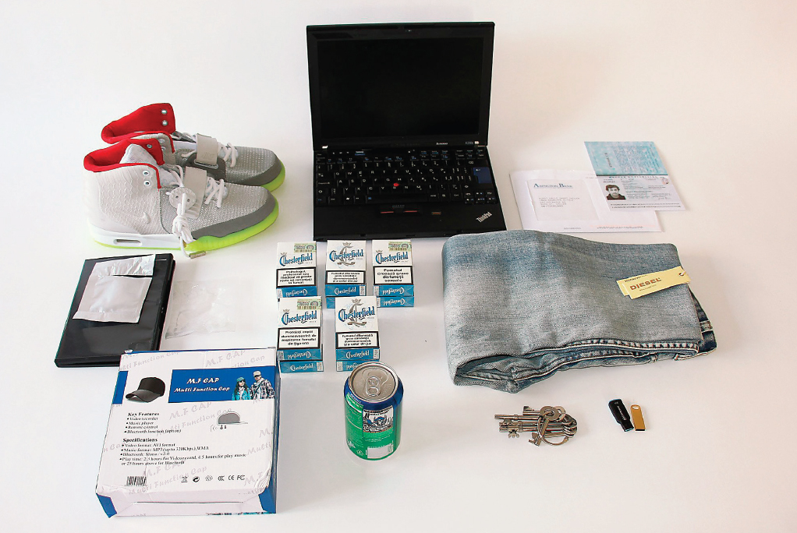
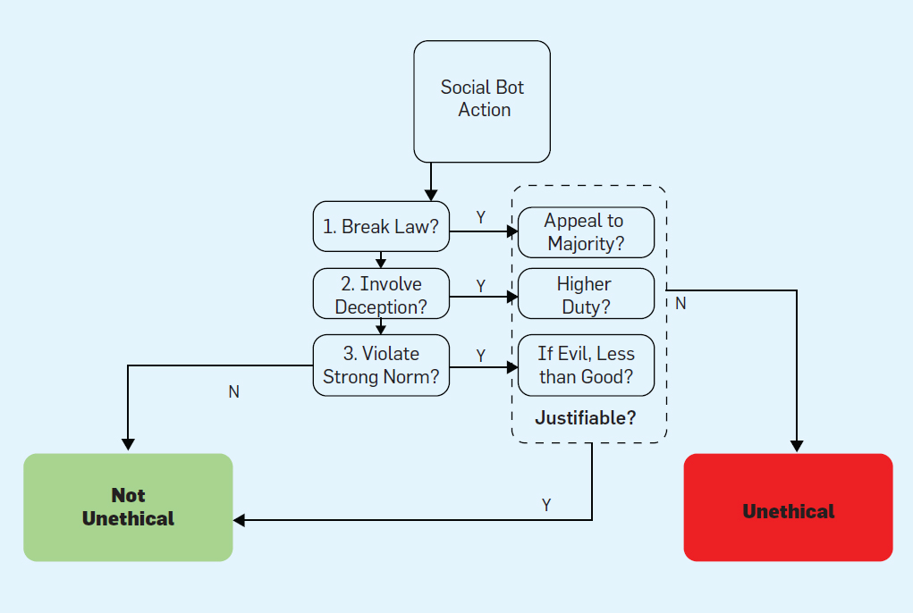
Ethics vs law: bot ethics
Items purchased by an automated computer program designed as an online shopping system that would make random purchases on the deep Web.
Carolina Alves de Lima Salge, Nicholas Berente
Communications of the ACM, Vol. 60 No. 9, Pages 29-31
DOI: 10.1145/3126492

Slide 17
Ethics and professional issues

Slide 18

Software malfunction
Mars Climate Orbiter
In 1999, communication with the Mars Climate Orbiter was lost due to a software problem
A contractor company developed the software that computed the impulse of the engine in pounds/sec
The NASA works with metric system
Notes:
A few case studies in which harm was caused:
150M cost to tax payers
ask a question about whose fault it is
requirements analysis at the contractor and QA and testing at NASA
deliberate, negligence or accidental

Slide 19
Human error?
Protocol flaw between the EHR of the nurses and doctors
No category for Ebola in the International Classification of Disease (ICD-9)
Notes:
accidental?

Slide 20
Illustrating ethical principles in CS research

Slide 21
Ethical principles
Attempts to operationalise and critically examine the moral that guides human conduct
Respect for autonomy
Beneficence
Non-maleficence
Justice

Slide 22
Ethical principles in Computer Science
Respect for autonomy
Involvement of participants in studies or experiments
Ethnography
Interviews
Focus groups
A/B testing
Informed consent is key but...
Might interfere with the study
Inconvenient
Notes:
Autonomy: do not interfere with free choice, protect vulnerable people, foster self-determination

Slide 23
The Facebook experiment

Slide 24
The Facebook experiment
Respect for autonomy
Notes:
Media reaction
Ask here, what makes a difference here?

Slide 25
The Facebook experiment
Respect for autonomy
https://www.facebook.com/legal/terms
Notes:
Legally safe
Terms of use

Slide 26
The Facebook experiment
Respect for autonomy

Slide 27
The Facebook experiment
Respect for autonomy

Slide 28
Ethical principles in Computer Science
Respect for autonomy
How to identify individuals?
How many? Why?
Inclusion criteria
Exclusion criteria
Protect vulnerable individuals
Consent, consent, consent!
How to give consent?
When to give consent? When to stop consent?

Slide 29

Ethical principles in Computer Science
Respect for autonomy

Slide 30
Ethical principles in Computer Science
Beneficence/Non-maleficence
Justified?
Of sufficient standard
Ethical research == good research
Risk assessment and precautions
Pain
Discomfort
Distress
Also for the researcher!
Notes:
Beneficence: act to benefit others; balance good results over potential harms
Non-maleficence: avoid harm; balance risks and seriousness of potential harms against benefits

Slide 31
Ethical principles in Computer Science
Beneficence/Non-maleficence
Anonymity
Confidentiality
Where is the data located?
How long will it be stored?
Is it encrypted?
Who has access?
Privacy
Data Protection Act 1998
Notes:
Beneficence: act to benefit others; balance good results over potential harms
Non-maleficence: avoid harm; balance risks and seriousness of potential harms against benefits

Slide 32
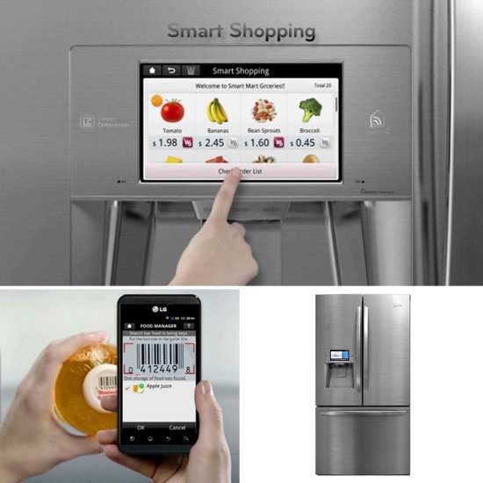
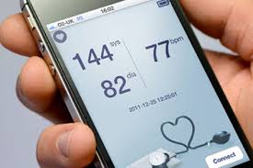
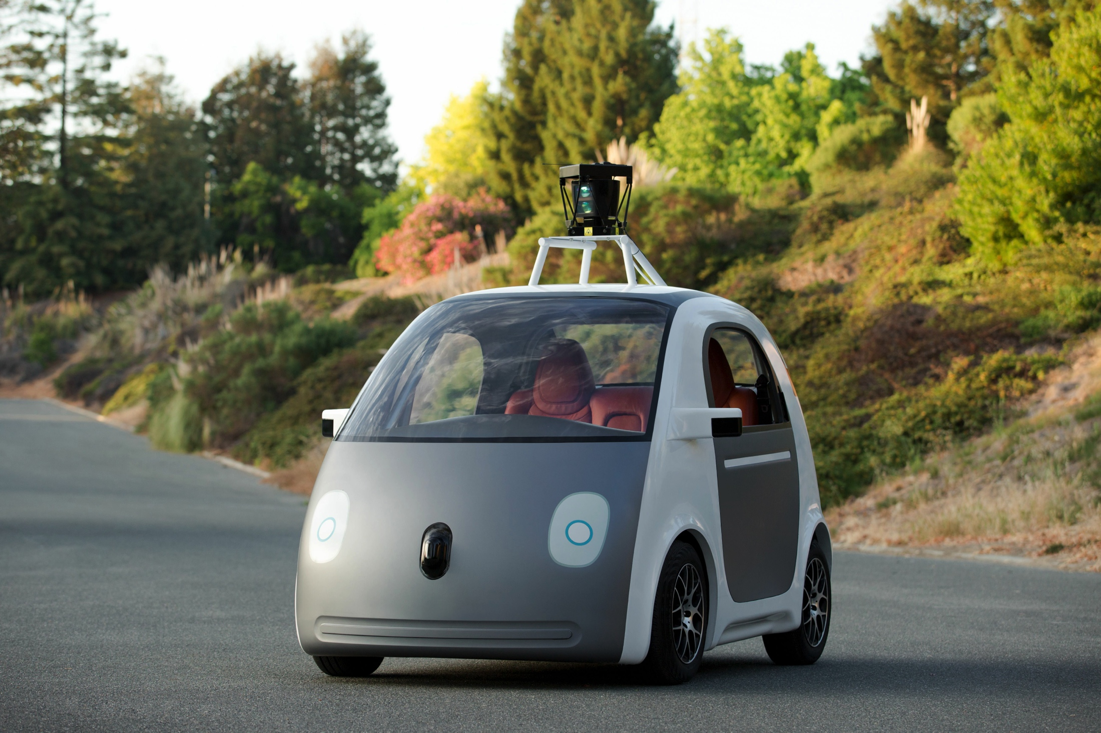
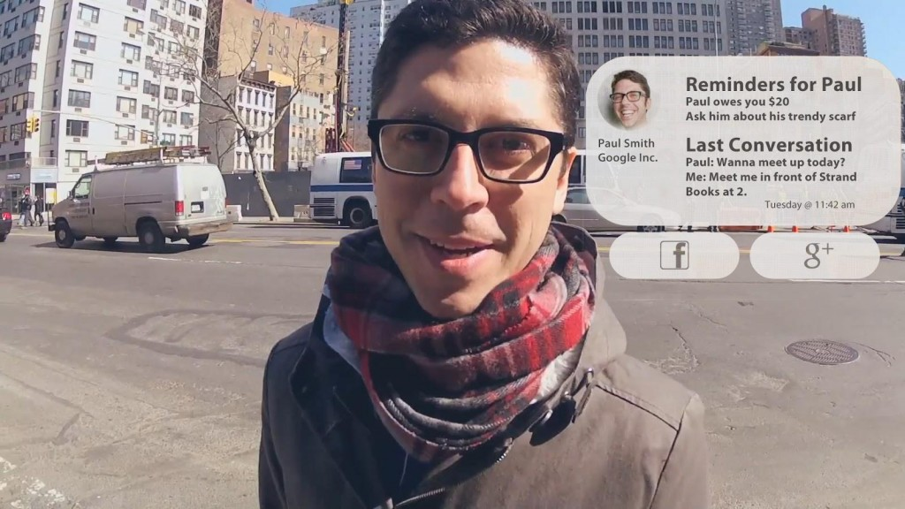
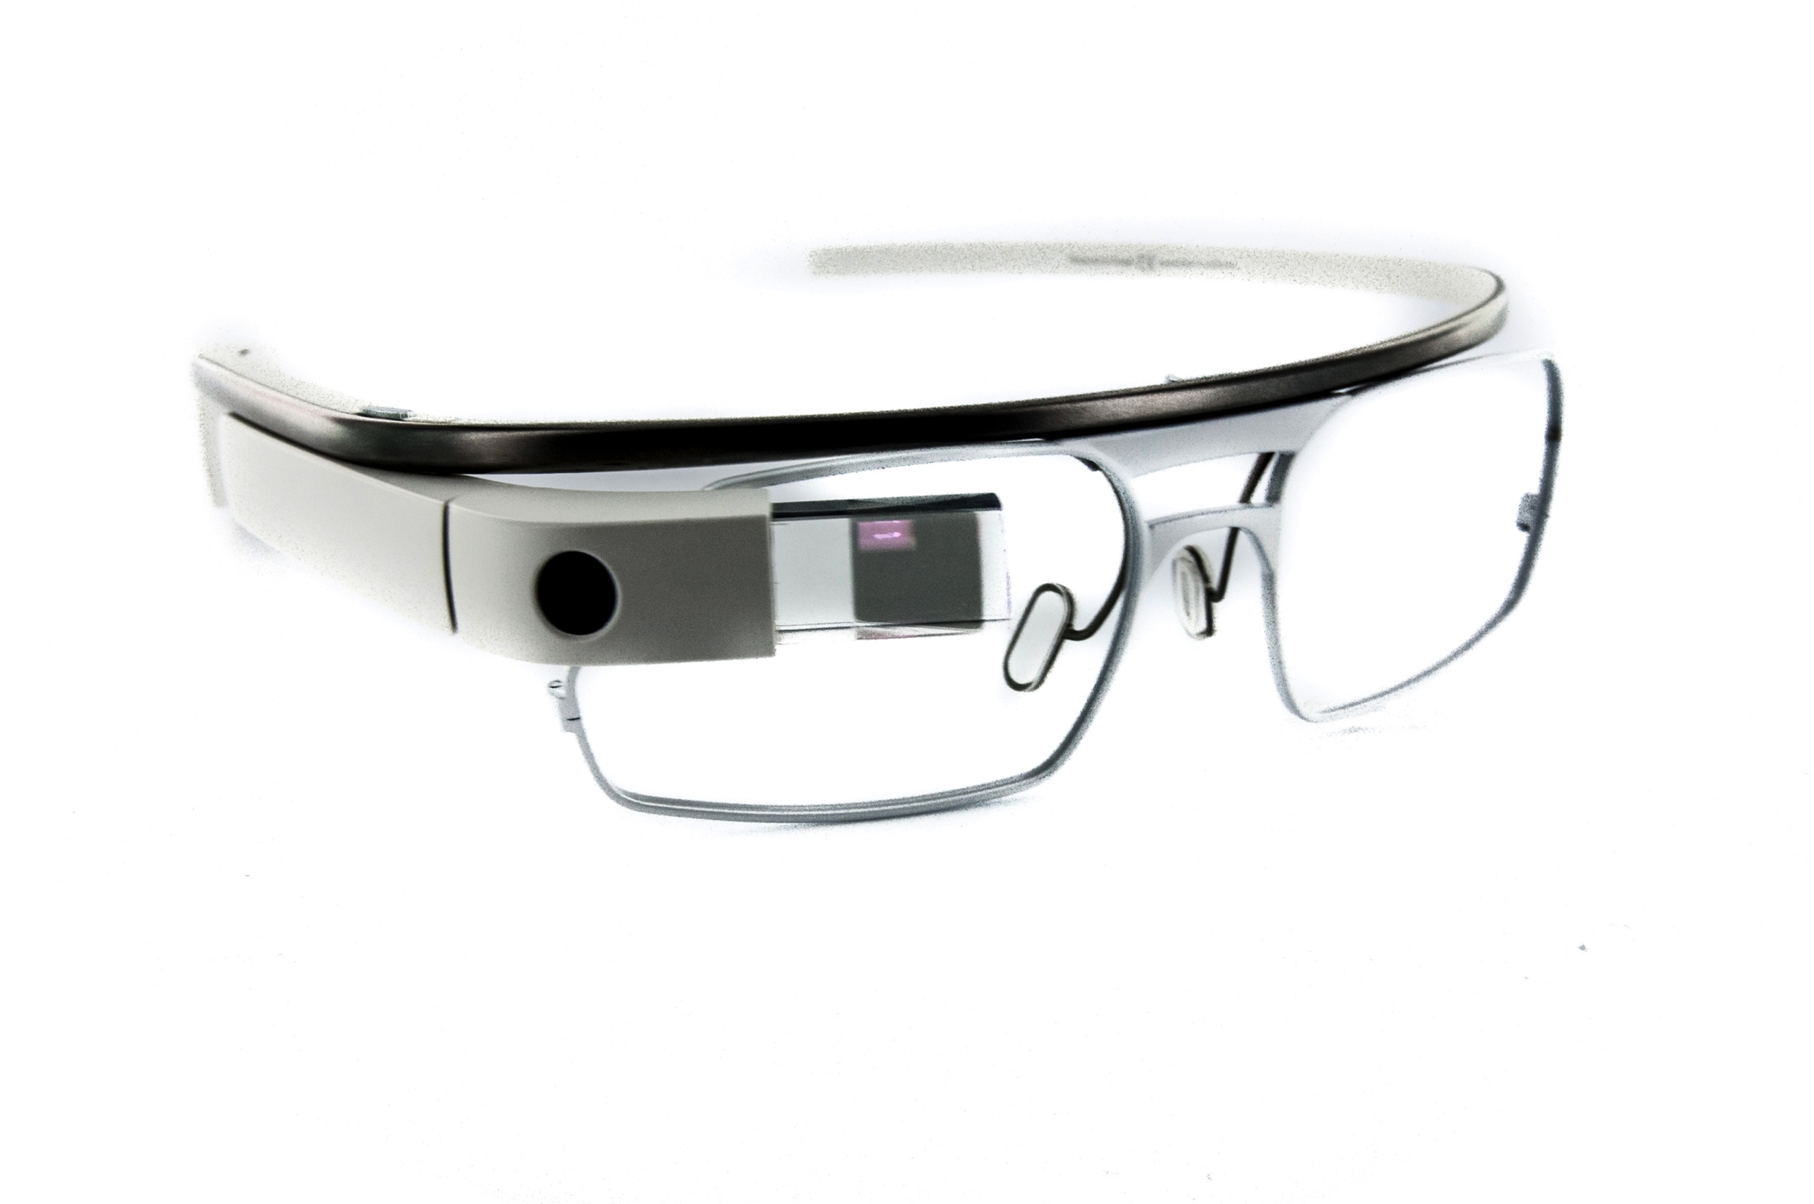
Current and future
challenges
Notes:
Anticipating is challenging but the key thing is to keep ethics in mind.
Internet of things
Mobile health and wearables
Augmented reality
Self-driving vehicles
These vehicles typically deal with uncertain situations by simply stopping. However, a child suddenly crosses the road, forcing the self-driving car to choose between hitting the child or swerving into an oncoming van. If that would avoid the child, if it would save the child’s life but the driver could be injured.

Slide 33

Ethics in CS research
Process
“I need ethical clearance for my project, what should I do now?”

Slide 34
Part II. University of Manchester Ethics Application Process

Slide 35
Find all the resources you need at
http://www.staffnet.manchester.ac.uk/services/rbess/governance/ethics/new-online-system-for-ethics-review-erm/
Ethics Decision Tool
Gateway to submission
Resources to fill out the application
Templates for the documents you need
PIS: participant information sheet
Consent form
FAQ documents

Slide 36
Ethics in CS research
Process
University Research Ethics Committees
Five committees
Meet once a month
Discuss applications from the university
Academics from all faculties
Review applications and interview applicants

Slide 37
Ethics in CS research
Process
Does this really apply to CS? YES!
Has to be signed-off within the School before upgrading to UREC
BUT, CS PGT projects rarely involve invasive procedures
Set of pre-approved templates
Think-aloud study or usability study
Questionnaire
Interview/focus group
In most cases, only needs to be considered by the CS Ethics Review Committee
Notes:
Fit to template. Compute the diff

Slide 38
Ethics in CS research
Workflow
Decide if you project need ethics approval for your research → Ethics Decision Tool
http://www.training.itservices.manchester.ac.uk/uom/ERM/ethics_decision_tool/story.html
Notes:
Fit to template. Compute the diff

Slide 39
Notes:
Fit to template. Compute the diff

Slide 40
Ethics in CS research
Workflow
Decide if you project need ethics approval for your research → Ethics Decision Tool
Apply for ethics → Ethical Review Management Tool (ERM)
https://submission-ethicalreview.manchester.ac.uk
Notes:
Fit to template. Compute the diff

Slide 41
Ethics in CS research
ERM Process: overview
Notes:
Fit to template. Compute the diff

Slide 42
Ethics in CS research
ERM Process: filter questions
Data Protection Statement
Have you checked you need ethical approval?
Access to clinical or personal records, or access to potential participants on the basis of their being or having been patients, access to NHS premises and staff → NHS Ethics
Research involving any form of risk or inconvenience to the participant
Research involving any risk of psychological damage or distress to the participants or their family
The use of novel techniques, even when apparently non-invasive, whose safety may be open to question
The collection of person-identifiable data requiring consent under the Data Protection Act
The participation of vulnerable individuals
Notes:
Fit to template. Compute the diff

Slide 43
Ethics in CS research
ERM Process
Notes:
Fit to template. Compute the diff

Slide 44
Ethics in CS research
ERM Process: contact info
Provide your contact details as well as your supervisor’s. Two choices:
Your supervisor fills out the application on your behalf
You fill out the application and you sign it
Notes:
Fit to template. Compute the diff

Slide 45
Ethics in CS research
ERM Process: school template
Description and soundness I
Short title of your research project
Will you be collecting data during the course of the research project?
Proposed start/end date of data collection
What type of study is this?
Questionnaire
Think Aloud Evaluation
Structured Interviews
Notes:
Fit to template. Compute the diff

Slide 46
Ethics in CS research
ERM Process: school template
Description and soundness II
Describe the principal research question/objective
Provide explanation of the purpose, design and methodology of the planned research
Please confirm the software that will be used to host the survey (if you are doing the questionnaire template)
https://apps.mhs.manchester.ac.uk/surveys
Notes:
Fit to template. Compute the diff

Slide 47
Ethics in CS research
ERM Process: school template
Consent
Are you going to request signed consent?
How many participants will be recruited?
How will you identify and select participants?
Personal letters or emails
Public domain directories or databases
Posters/advertisements
Email distribution lists
Other
Enter the text used for recruitment
Will participants receive an incentive for taking part?
Notes:
Fit to template. Compute the diff

Slide 48
Ethics in CS research
ERM Process: school template
Assessment of risks
What is the potential for adverse effects including potential for pain, discomfort, distress or inconvenience?
How will risks or inconvenience to the participant/researcher be minimised ?
How long do you anticipate the total duration of participation for each participant?
Notes:
Fit to template. Compute the diff

Slide 49
Ethics in CS research
ERM Process: school template
Data confidentiality and anonymity
Will the data be stored in a secure place at all times?
What measures have been put in place to ensure confidentiality of personal data?
Who will control the data generated during the study and act as its custodian?
Who will have access to the data generated by the study?
Will the data be kept for 5 years?
Notes:
Fit to template. Compute the diff

Slide 50
Ethics in CS research
Workflow
Decide if you project need ethics approval for your research → Ethics Decision Tool
Apply for ethics → Ethical Review Management Tool (ERM)
Submit and wait
Notes:
Fit to template. Compute the diff

Slide 51
Ethics in CS research
Workflow
Notes:
Fit to template. Compute the diff

Slide 52
Ethics in CS research
Workflow
Decide if you project need ethics approval for your research → Ethics Decision Tool
Apply for ethics → Ethical Review Management Tool (ERM)
Submit and wait
Outcomes (after 1-3 weeks)
It does not fit with the CS templates → escalate
It fits with the CS templates
No problems: approved
There are issues: update and resubmit. GOTO 3
Notes:
Fit to template. Compute the diff

Slide 53
Ethics in CS research
Summary
Involving humans is an important part of CS research
Unlike biologists and clinicians we are not used to it
Supervisor should advise you
Online resources and application process
Ask me ethics@cs.manchester.ac.uk
Notes:
Fit to template. Compute the diff

Slide 54
Part 3. Discuss the proposed scenarios

Slide 55
Question
When somebody dies, what happens to their social network profile?

Slide 56
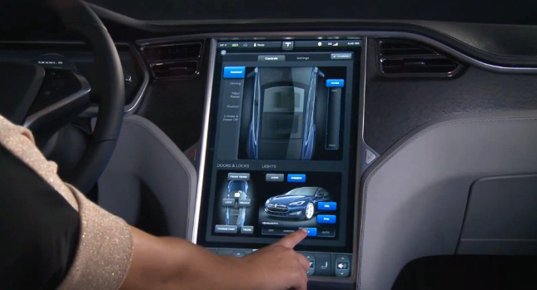
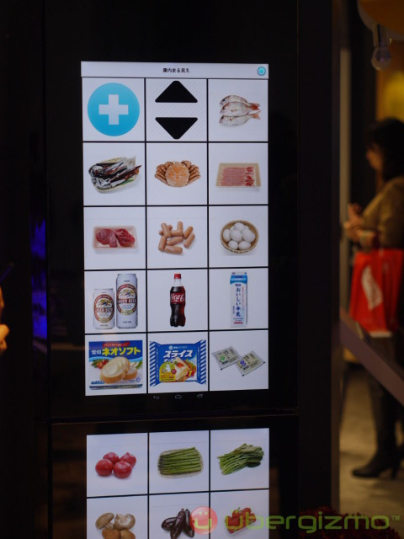


Scenarios
Usability study of an in-car user interface
Study of usage of smart appliances
Analysis of American politics in social media
Online survey about attitudes towards online dating

Slide 57
Schedule: self-study
Task 1. Do and finish part 3 in groups
Task 2. Reflect on whether your project needs ethical approval
→ To be included in the ‘Project overview and plan’ report.

Slide 58
Part 4. Report your results

Slide 59
Scenarios
Usability study of an in-car user interface
Study of usage of smart appliances
Analysis of American politics in social media
Online survey about attitudes towards online dating

Slide 60
Ethics in Computer Science Research
COMP 60990
Markel Vigo
markel.vigo@manchester.ac.uk
Bio-Health Informatics Group
Notes:
Why me?
In the following weeks you will choose a MSc project

